Slide 1
Capstone Project -Market Sales Prediction Regression Model
Bawani A. Guruge
Dialog Axiata
Registration Number- 252

Slide 2
1.0 Introduction
This project focuses on sale prediction of a logistic company.
The dataset was collected for 60 days, this is a real database of a Brazilian logistics company.
The dataset has twelve predictive attributes and a target that is the total of orders for daily treatment.
The problem was considered as a regression type machine learning model.

Slide 3
2.0 Data
The data was taken from ‘Daily Demand Forecasting Orders Data Set’ in the UCI Machine Learning Repository.
The data was represented in 13 columns and 60 rows.
The column names of the data were long so changed column names which is easier to use in the model.
There were no missing values or duplicates in the dataset. All columns were either int or float data type.
Outliers were removed from the total order column.

Slide 4
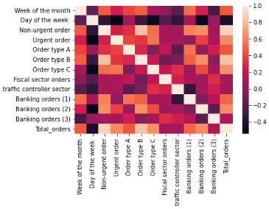
3.0 Methodology
Data pre-processing was conducted. After conducting the data cleaning correlation matrix was drawn to identify any relationship between the variables.
X and Y variables were identified as below. ‘Days of the week’ was neglected from the X features due to the less relationship it showed to the other variables.
Linear Regression model was used with while using 70% for training data and 30% for testing data.
Multiple iterations were conducted to see which features can make a difference to the metrices. MSE, RMSE and R2 values were obtained to evaluate the performance of the regression model.

Slide 5
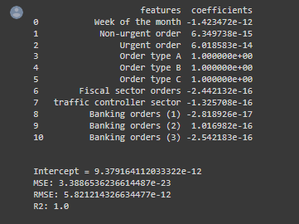
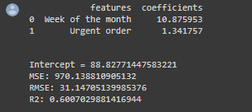
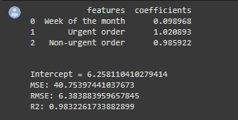
4.0 Results

Slide 6
5.0 Conclusion and Discussion
The skill or performance of a regression model must be reported as an error in those predictions. We cannot calculate accuracy for a regression model. Hence MSE, RMSE and R2 values were obtained.
While using all the variables for X, the model was able to get R2 score of 1. And in-order to check the accuracy, 2nd and 3rd iterations were conducted. Model was able to get R2 score of 0.98 with the variables urgent order, non-urgent order and week of the month. This can be considered important features for the X variable while we consider the target orders per week.

